Slide 1
Elo rating system
It is a numerical rating system that was originally invented by Arpad Elo, a Hungarian-American physics professor and chess player.
The Elo rating system is based on the idea that a player's rating should reflect their probability of winning against another player. The higher a player's rating, the more likely they are to win against a lower-rated player.
Lee Sedol: 3,778
Ke Jie: 3,766
AlphaGo: 3,900
AlphaZero: 4,823

Slide 2
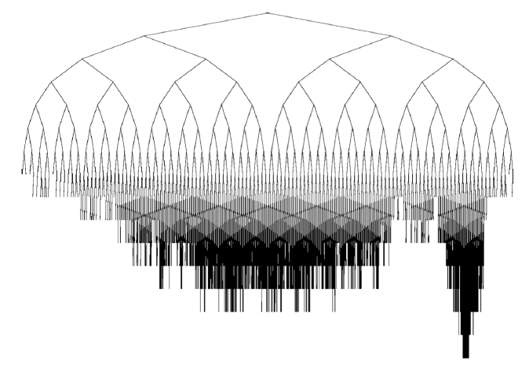
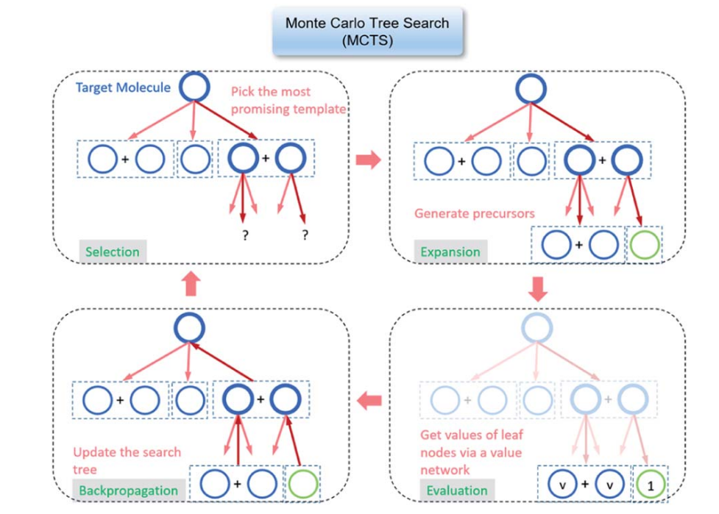
Monte Carlo tree search (MCTS)
a probabilistic algorithm for searching through a game tree.
Go, chess, and shogi.
main steps: selection, expansion, simulation, and backpropagation.
a powerful tool for searching through game trees.

